Slide 1

BAPUJI EDUCATIONAL ASSOCIATION ®
BAPUJI INSTITUTE OF ENGINEERING AND TECHNOLOGY, DAVANAGERE – 577 004
DEPARTMENT OF ELECTRONICS & COMMUNICATION
PROJECT PHASE-II PRESENTATION
On
Biometric Based Payment System
PROJECT ASSOCIATES
S SUHAS | 4BD20EC060
SHREYAS P | 4BD20EC066
VYSHNAVI H K | 4BD20EC090
CHITRA A | 4BD21EC408
Dr. BANUMATHI K L
M.Tech , Ph.D.
PROJECT GUIDE
Dr. G S SUNITHA
M.Tech.(DEAC), Ph.D., MISTE, FIETE, FIE
PROGRAM COORDINATOR

Slide 2
INSTITUTE VISION
To be a center of excellence recognized nationally and internationally, in distinctive areas of engineering education and research, based on a culture of innovation and invention.
INSTITUTE MISSION
BIET contributes to the growth and development of its students by imparting a broad based engineering education and empowering them to be successful in their chosen field by inculcating in them positive approach, leadership qualities and ethical values.

Slide 3
VISION OF THE DEPARTMENT
To be in the forefront in providing quality technical education and research in Electronics & Communication Engineering to produce skilled professionals to cater to the challenges of the society.
MISSION OF THE DEPARTMENT
To facilitate the students with profound technical knowledge through effective teaching learning process for a successful career.
To impart quality education to strengthen students to meet the industry standards and face confidently the challenges in the programme.
To develop the essence of innovation and research among students and faculty by providing infrastructure and a conducive environment.
To inculcate the student community with ethical values, communication skills, leadership qualities, entrepreneurial skills and lifelong learning to meet the societal needs.

Slide 4
COURSE LEARNING OBJECTIVES
This course will enable us to:
Prepare with foundation knowledge in a project domain through designing, and implementing.
Introduce to various emerging fields in electronics and communication.
Provide an opportunity to exercise the creative and innovative qualities, to become technopreneurs in group project environment.
Have hands-on experience in the related field so that students can integrate and reinforce what has been taught in the classroom.

Slide 5
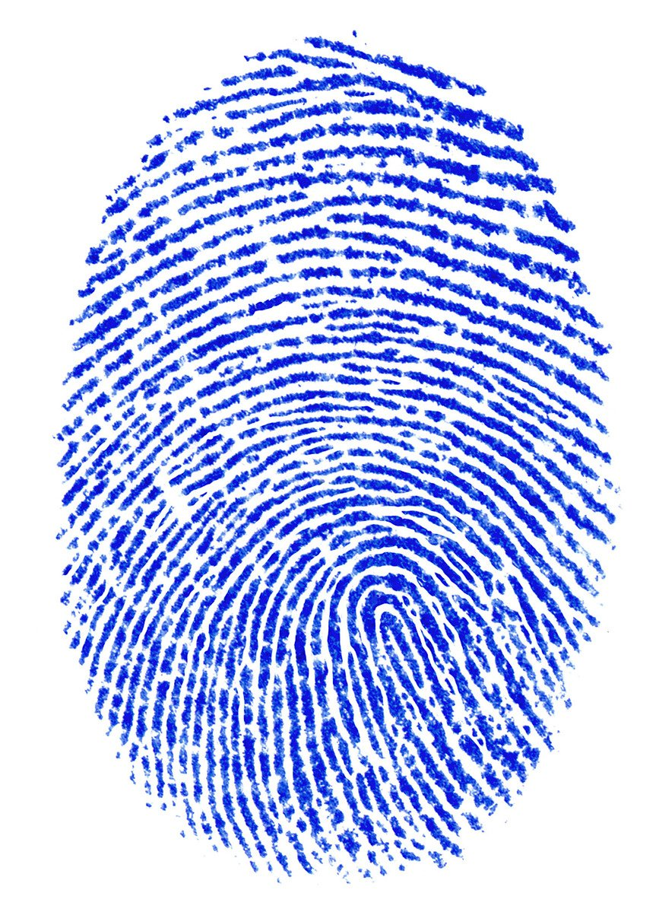
Contents:
Introduction
Literature Survey
Problem Identification
Project Title
Objectives
Features
Methodology
Hardware Requirements
Software Requirements
Applications
Advantages and Limitations
Result
Technology comparison
Conclusion
Reference

Slide 6

Introduction:
Biometric payment is a Point-Of-Sale (POS) technology that uses biometric authentication based on physical characteristics to identify the user and authorize the deduction of funds from a wallet.
Fingerprint payment based on finger scanning, is the most common biometric payment method. Often, in which the finger scan takes place of the user to access the users wallet for payments.
This technology offers a more secure and convenient alternative to traditional cash and IC card payment methods. Cash payment can be slow and inconvenient due to the tendering of change, while IC card payment is more efficient, lacks a robust authentication process making it vulnerable to fraud.
Fingerprint payment with its unique biometric authentication addresses both of these concerns providing a secure and hassle-free payment experience.

Slide 7
Literature survey summary:
Paper Authors | Paper title | Technology Used | Concept Implemented in our project
Dr.ChitraKiran.N, Suchira Suresh, AkarshS.M, BhuvanTeja, Krishna.B Jerrin Yomas | A Biometric based Payment System by using Payee and Payer Module | Payer and Payee module using ARM Cortex m3. | Payee module
Bin RONG and Chang-hua LIU | A Fingerprint Payment System Based on FPGA | FPGA as control center module. | Fingerprint enrolment.
Dileep Kumar and Yeonseung Ryu | A Brief Introduction of Biometrics and fingerprint payment technology | POS using microcontroller and fingerprint sensor. | Wallet based payments
R.Logeshwari, M.Saikoteswara, M.V.Sudeerkumar and J.S.R.K Suryateja | Fingerprint Based online payment system | By integrating fingerprint biometrics from UIDAI. | Storage of data in server
Yan Sui , Xukai Zou and Yinozi Du | Biometrics-Based Authentication: A New Approach | Stores difference between the user and the Reference Subject for authentication without revealing a user's original biometric information. | Encryption (Hash) of the user data.

Slide 8
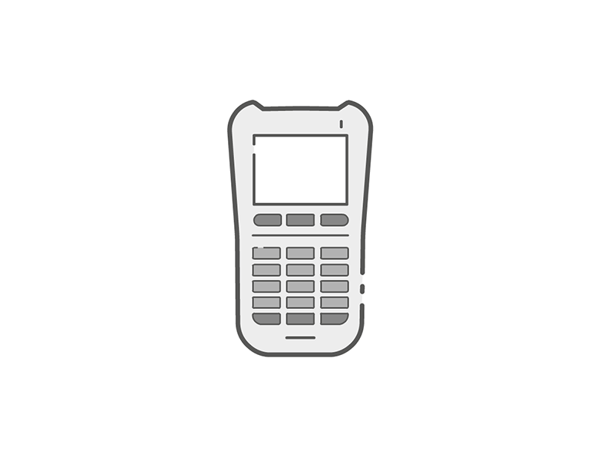
Problem identification:
Traditional payment systems are vulnerable to security breaches, as cards can be cloned, PINs can be stolen, and sensitive payment information can be compromised.
Remembering multiple passwords and PINs for different cards and accounts can be inconvenient and can lead to declined transactions when forgotten.
Physical cards can be lost or stolen, creating hassle and potential financial losses if they fall into the wrong hands.

Slide 9
Project title:
Biometric Based Payment System

Slide 10

Objectives:
To integrate and evaluate sensor modules for fingerprint capture, ensuring compatibility with the ESP32 environment.
To develop a secure system for users to link their fingerprint data with their payment information.
To enable secure and fast transactions using fingerprint authentication for payment processing.

Slide 11

Features:
Fingerprints are unique and difficult to replicate or forge, greatly reducing the risk of fraudulent transactions compared to traditional passwords or PINs.
No need to carry physical cards or remember passwords, fingerprint becomes your secure payment key.
Biometrics provide a convenient payment method that works seamlessly for all users.
Fingerprint authentication can significantly speed up the checkout process, improving the customer experience.

Slide 12
Block Diagram:
Power Supply
ESP32
R307 Fingerprint Sensor Module
1.3” OLED display
HTTP
Protocol
IoT
(web server)
4X4 Keypad
Fig1: Block Diagram of Biometric based payment system

Slide 13
Methodology:
The biometric payment system uses fingerprint identification to allow users to make secure and convenient payment transactions.
It operates in two primary modes:
Enrollment Mode
Payee Mode
Enrollment Mode:
The system guides the user to begin the enrollment process (by displaying on OLED).
The fingerprint sensor captures two images of the same finger.
The images are processed to create a unique and reliable fingerprint template.
The generated template is transmitted over a secure network connection to a central server or securely stored in the device's memory (non-volatile, such as EEPROM or Flash) in case of no network and associated with a unique ID.
The system indicates success or failure of the enrollment (by displaying on OLED).

Slide 14
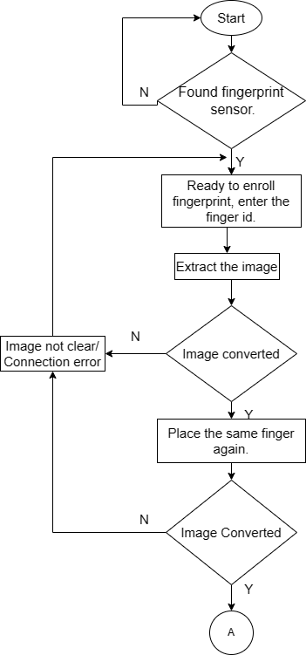
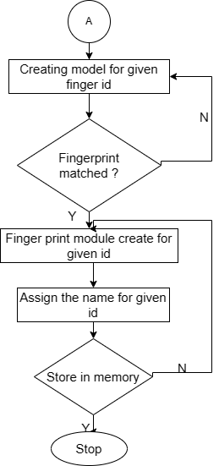
Enrolment mode

Slide 15
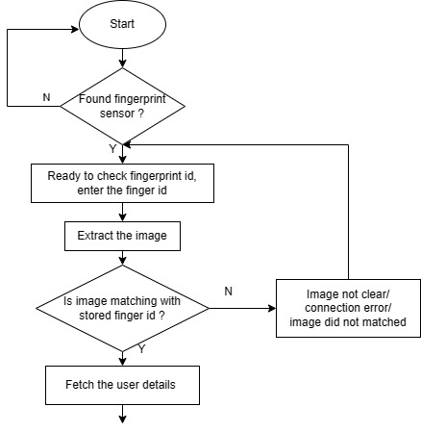
Payee Mode
B

Slide 16
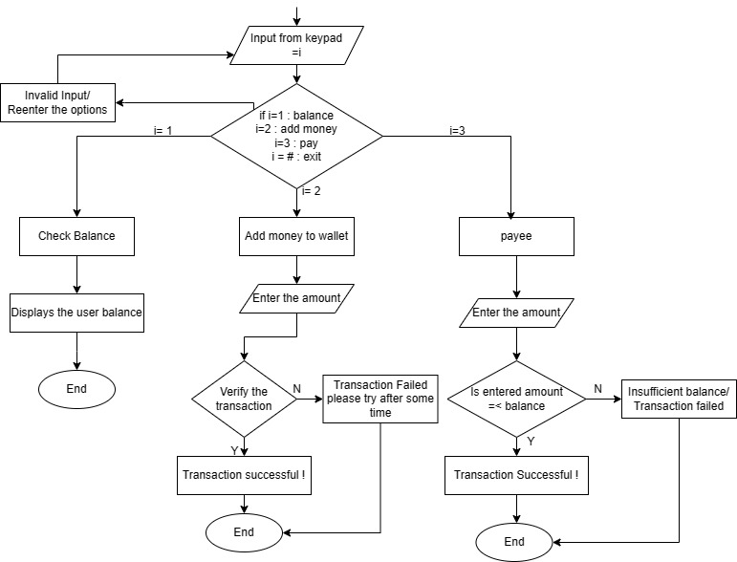
B

Slide 17
Payee Mode
The system requests the user to place their finger on the sensor for authentication.
The sensor obtains a new fingerprint image.
The captured image is compared against stored fingerprint templates.
If a match is found, the system presents the user with choices (Balance, Add Money, Pay, Exit) on the OLED display.
The keypad is used to collect the user's selection.
The system executes the chosen action:
Balance: Retrieves and displays the current wallet balance.
Add Money: Provides an interface to add funds to the wallet.
Pay: Initiates a secure payment process, contingent on sufficient balance.
Exit: Ends the payee session.
The system communicates the payment status to the user (success/failure).
Transaction data is either transmitted over a secure network connection to a central server or stored locally (e.g., SD card) with appropriate safeguards for enhanced record-keeping and traceability.
For each completed transaction, essential details are captured, which the user can later access.

Slide 18
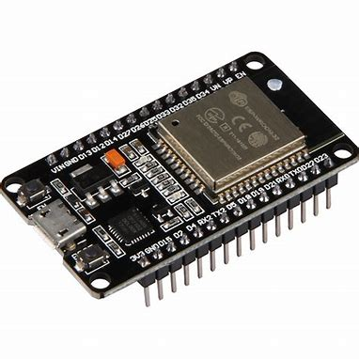
Hardware Requirements:
ESP32 :
The ESP32 is a series of low-cost, low-power System-on-Chip (SoC) microcontrollers with integrated Wi-Fi and Bluetooth capabilities.
Powerful and Versatile Processor:
Dual-core (or single-core in some variants) Tensilica Xtensa LX6 32-bit processor, clock speeds up to 240MHz.
Wireless Connectivity:
Integrated Wi-Fi (802.11 b/g/n) and Bluetooth 4.2 (BR/EDR) + BLE (Bluetooth Low Energy).
Abundant Peripherals:
34 GPIO pins, support for interfaces like UART(universal asynchronous receiver transmitter), I2C, SPI, I2S, touch sensors, Hall sensor, ADC, DAC, and more.
Security:
Hardware-based security features like secure boot, flash encryption and cryptographic accelerators.
Fig2: ESP32

Slide 19
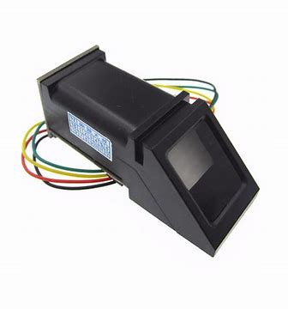
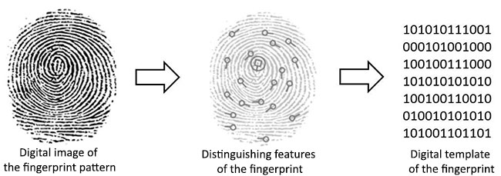
R307 fingerprint sensor module:
The R307 fingerprint sensor module captures and recognizes fingerprints. It uses an optical sensor to capture fingerprints.
Typically communicates via a TTL(transistor transistor logic) UART interface, making it compatible with microcontrollers .
Includes a DSP processor for handling fingerprint enrollment, image processing, matching, and template management.
It is used for scanning fingerprints of user.
Fig3: R307 Fingerprint sensor module
Fig4: Working principle of fingerprint sensor module

Slide 20
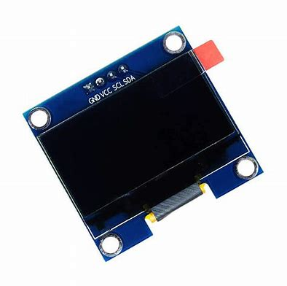
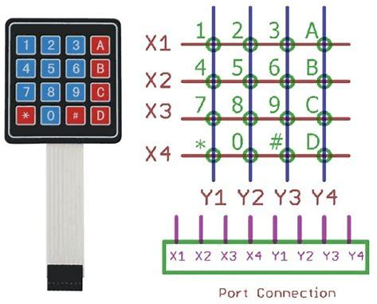
1.3″ OLED display :
The 1.3″ OLED display is perfect when in need of an ultra-small display. It is an OLED monochrome 128×64 dot matrix display module with I2C Interface.
It is used for displaying appropriate information of user.
Fig5: 1.3” OLED display
4×4 matrix keypad:
The 4×4 matrix keypad is an input device.
It has 16 keys in total, which means it can provide 16 input values.
It used only 8 GPIO pins of a microcontroller.
Fig6: 4X4 Matrix keypad

Slide 21
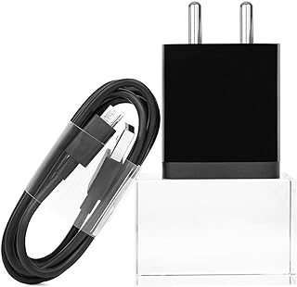
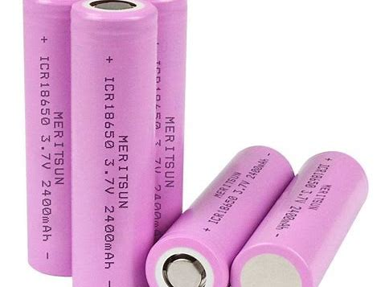
Power Supply:
5 Volt 2 Amp Power Adapter takes an AC INPUT of 100-240V and gives 5V 2A DC output.
18650 li-ion battery:
Fig7: 5V 2A DC Adapter
The 18650 battery has a standardized cylindrical shape with dimensions of 18mm in diameter and 65mm in length. Its capacity typically ranges from 1800mAh to 3500mAh, with the most common being around 2600mAh to 3000mAh.
The nominal voltage of an 18650 battery is 3.7 volts, and it is fully charged at 4.2 volts. The discharge cutoff voltage is usually around 2.5 to 3.0 volts.
Fig8: 18650 li-ion battery

Slide 22
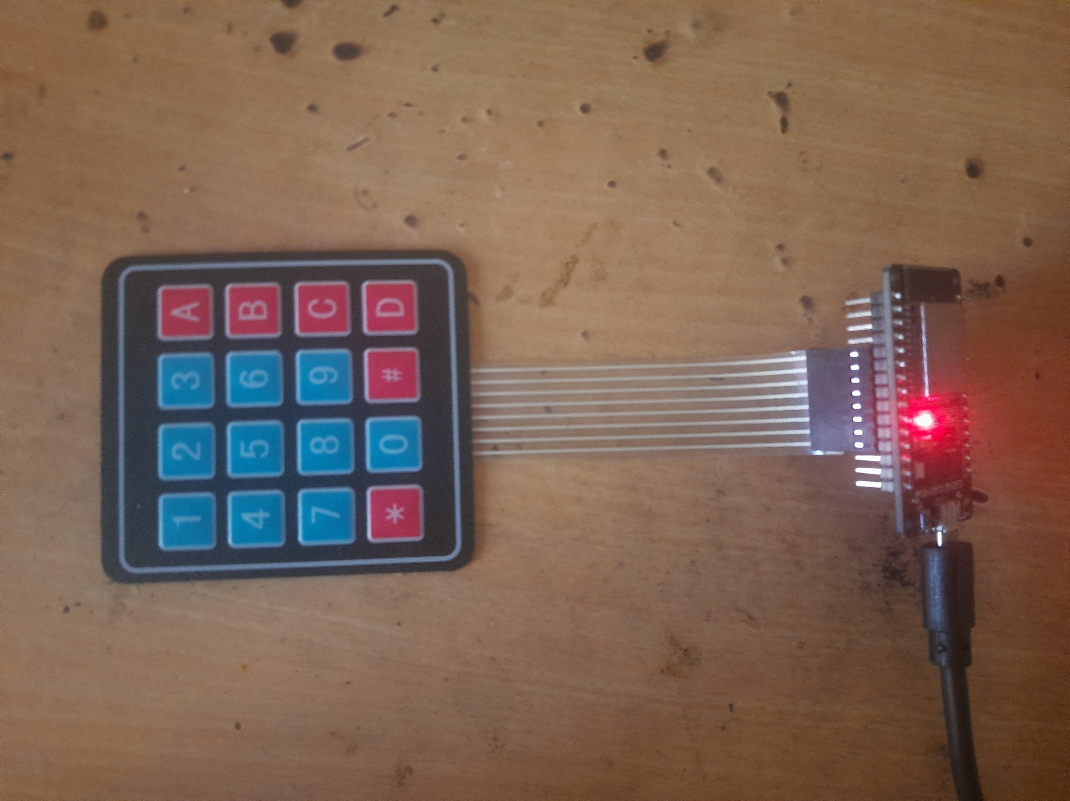

Interfacing
Keypad Interface
Power supply
Vcc
Gnd
ESP32
FF4X4 Matrix
Keypad
GPIO13
GPIO12
GPIO14
GPIO27
GPIO26
GPIO25
GPIO33
GPIO32
Fig 9: Keypad Interface

Slide 23
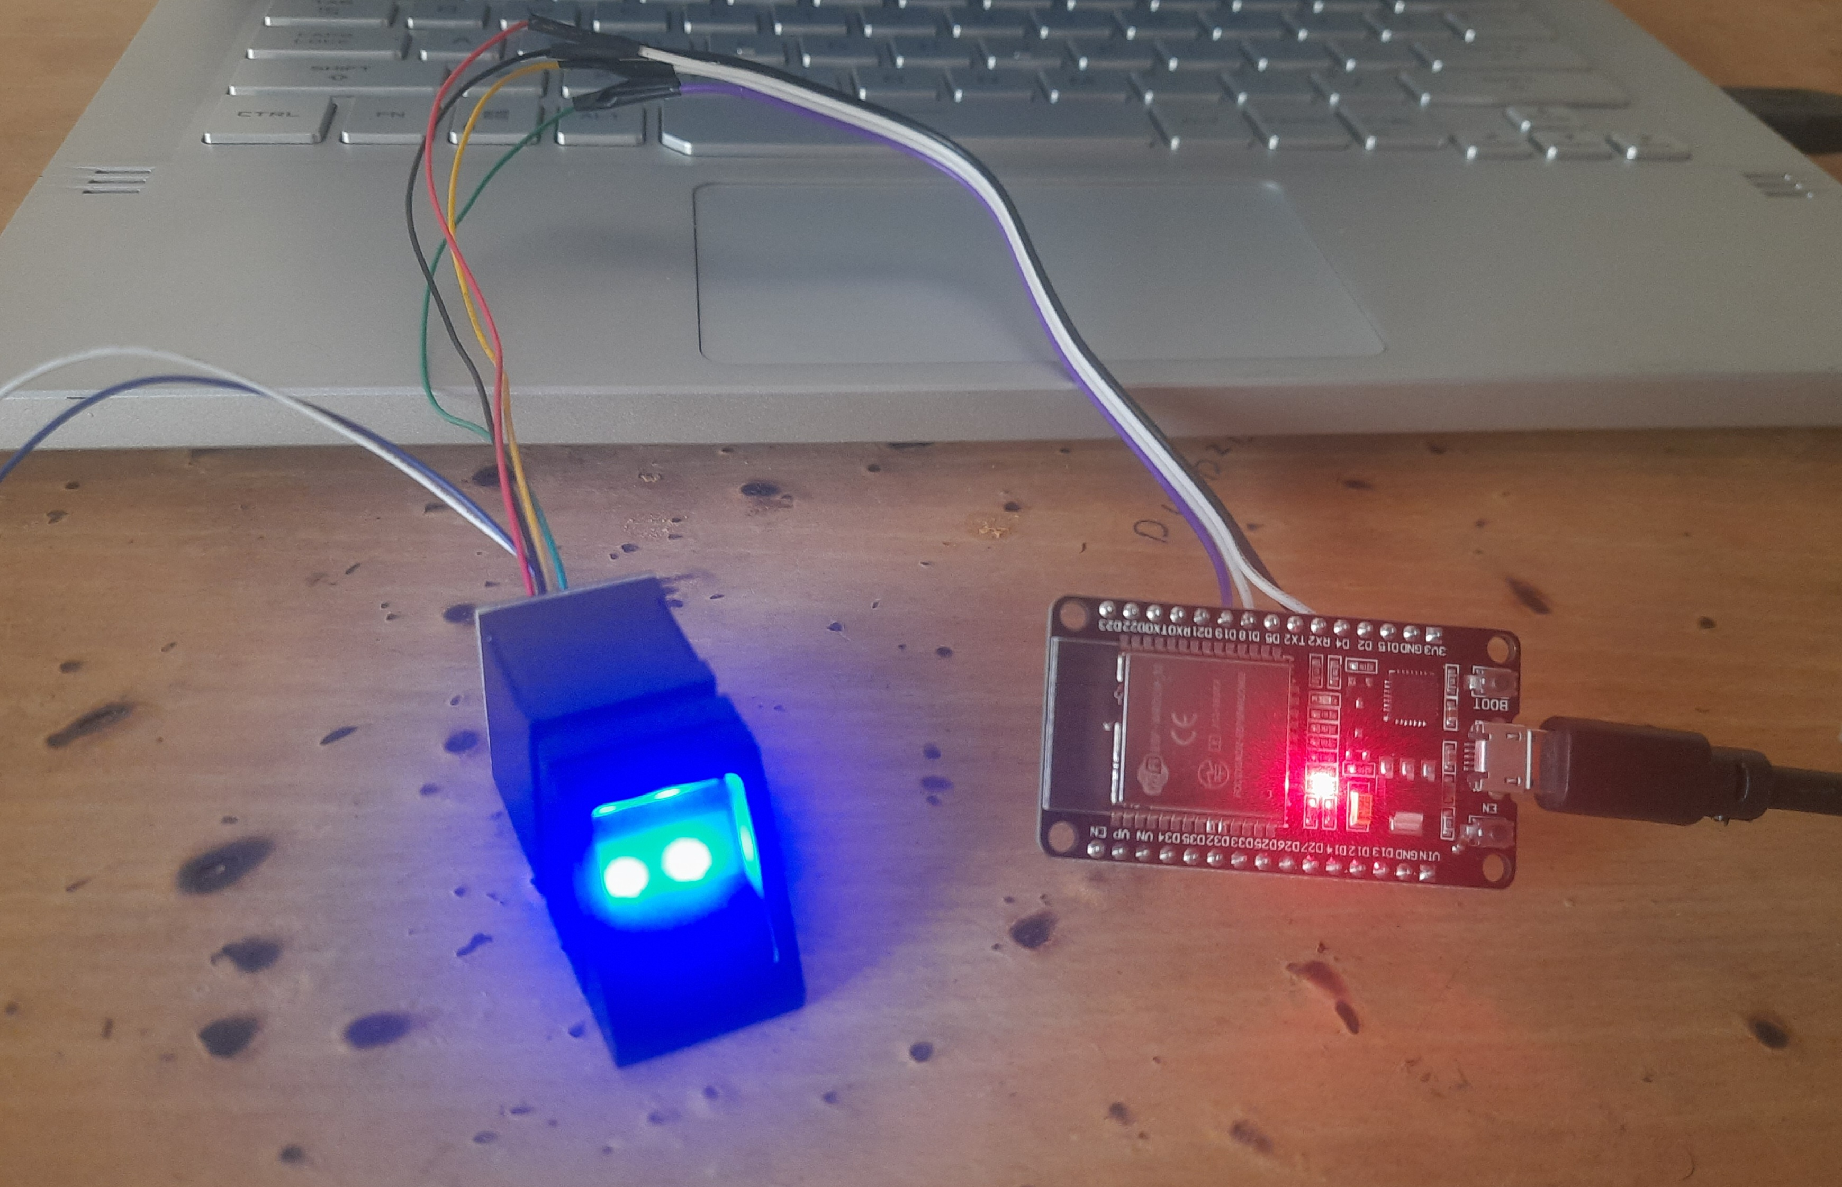
R307 Sensor Module Interface
Power supply
ESP32
Vcc
Gnd
FFFingerprint sensor
Vcc
Gnd
Tx
Rx
GPIO17 Rx
Hardware-Serial
GPIO16 Tx
Fig 10: R307 Interface.

Slide 24
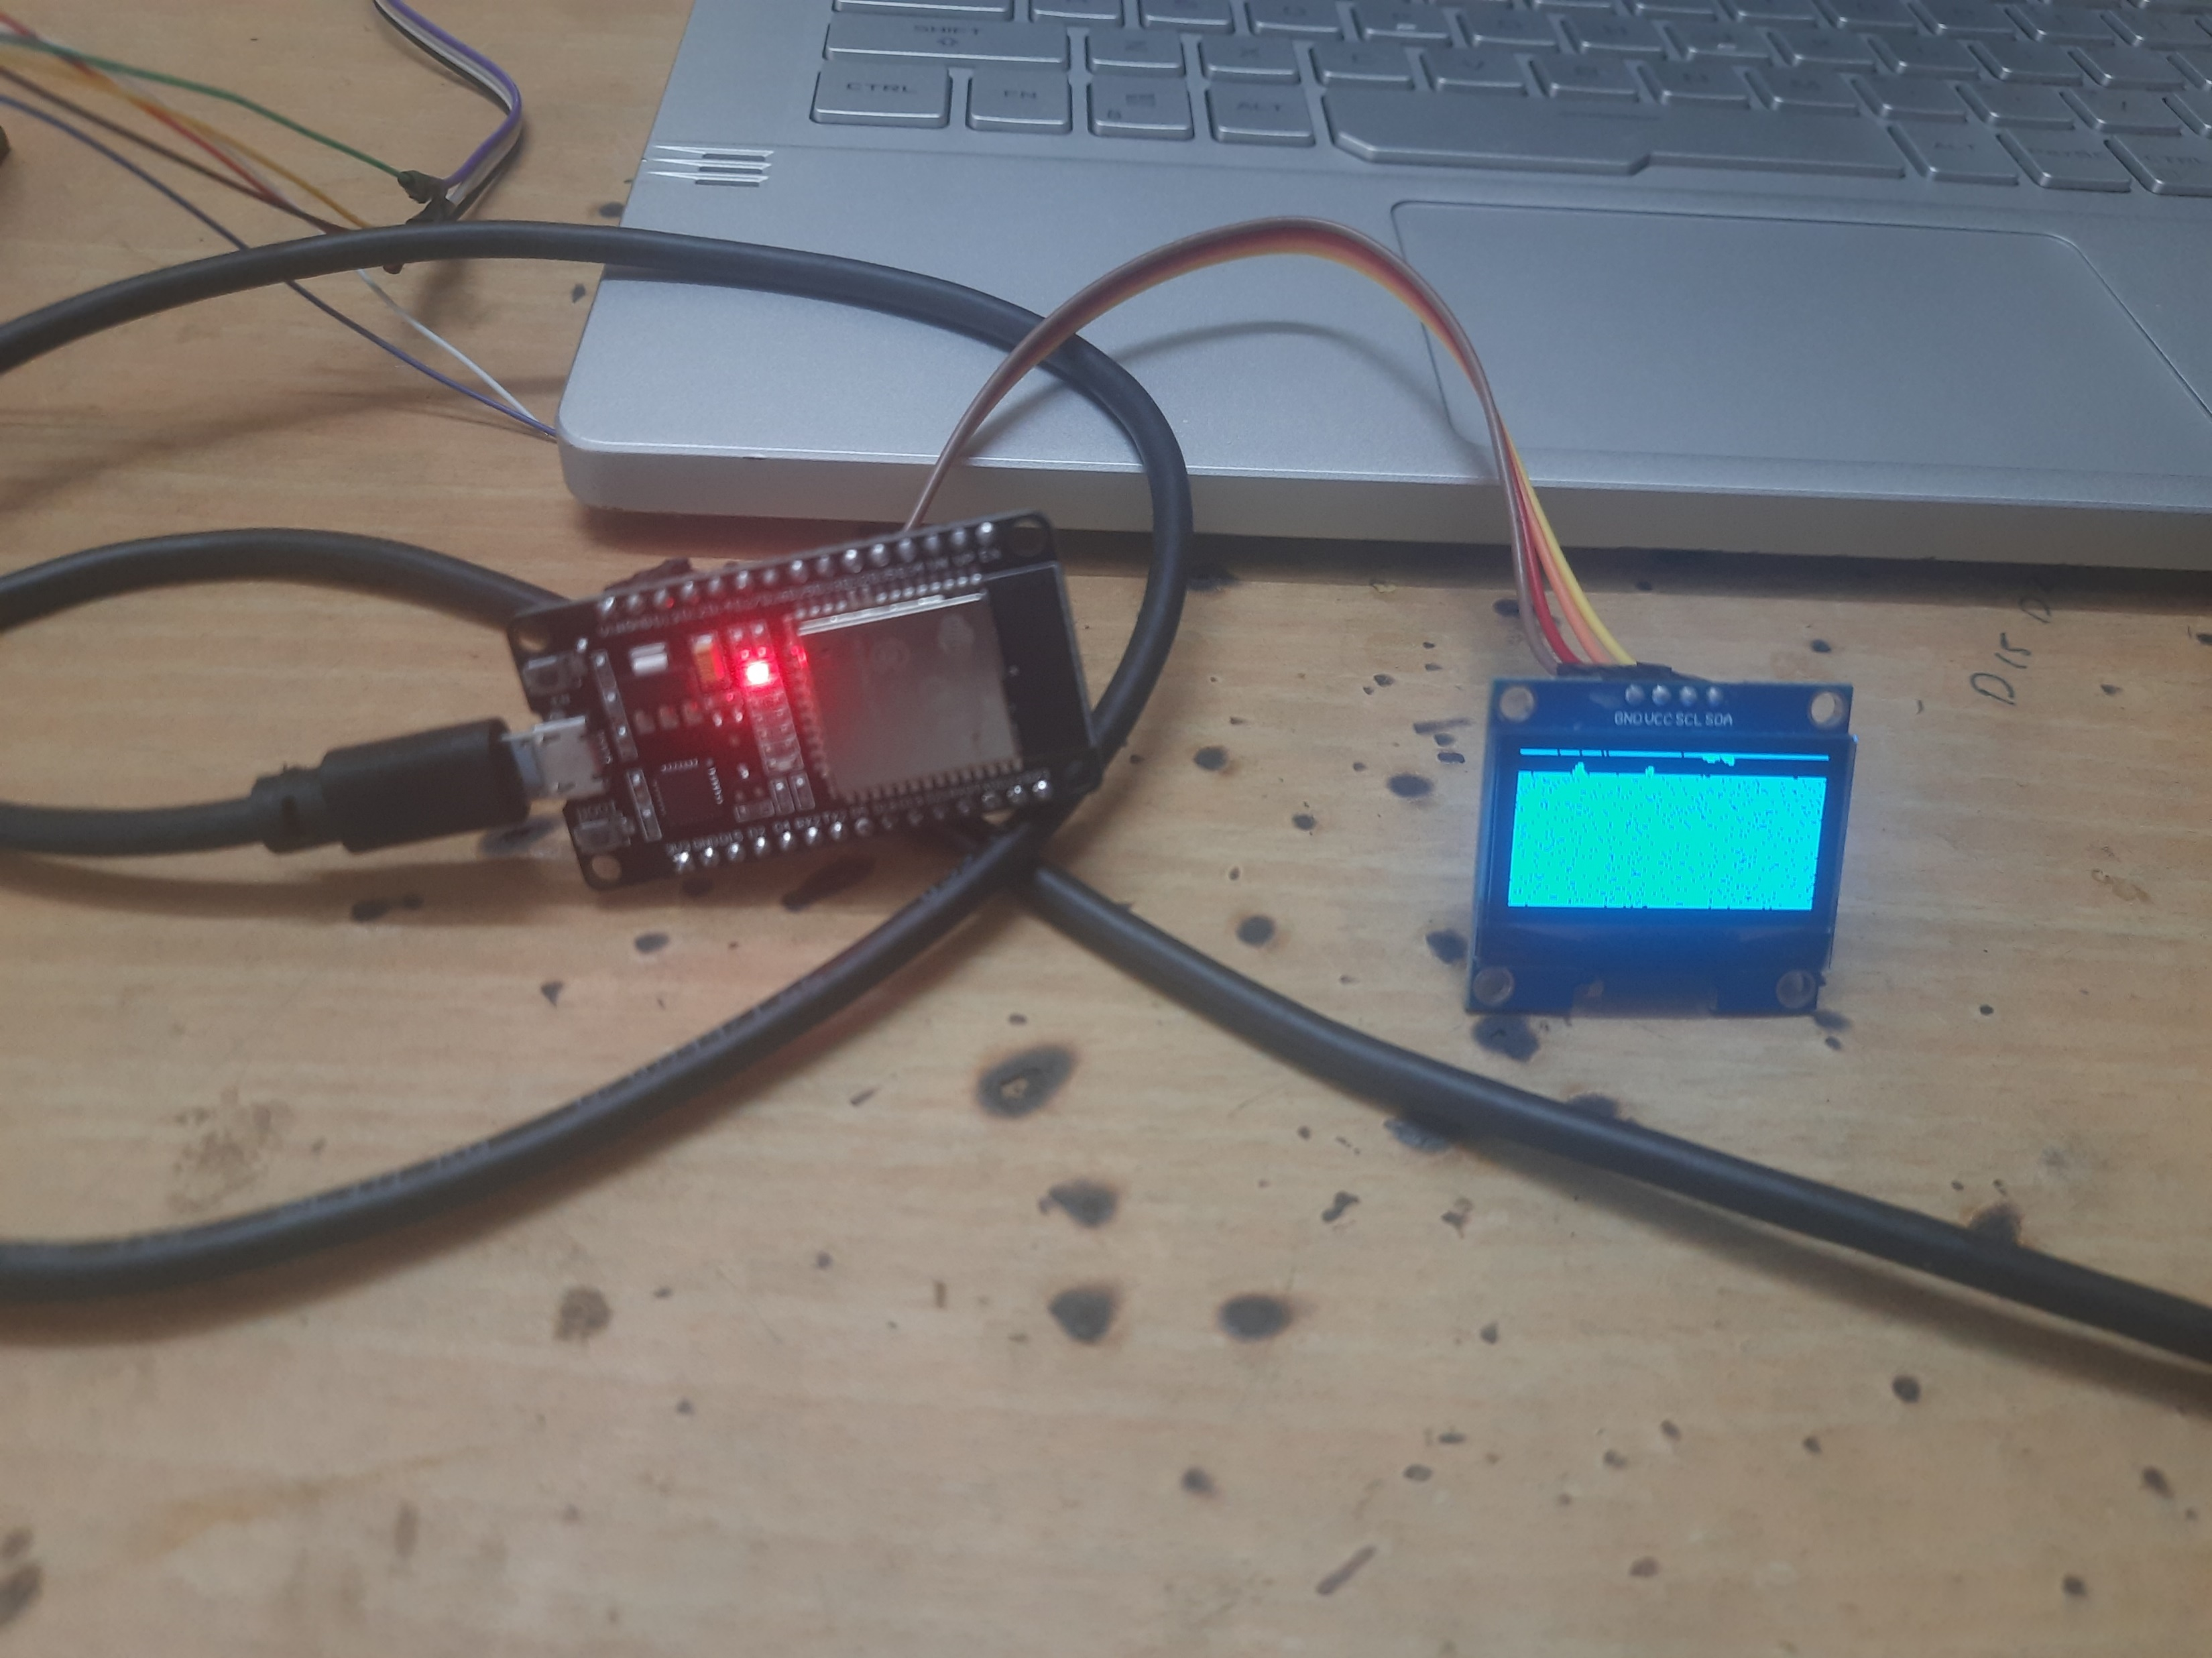
OLED Interface
Power supply
ESP32
ESP32
Vcc
Gnd
FFOLED I2C
Vcc
Gnd
SCL
SDA
SCL
GPIO 21
SDA
GPIO 22
Fig 11: OLED Interface.

Slide 25
Schematic Diagram:
Power supply
FF4X4 Matrix Keypad
Vcc
Gnd
FFOLED I2C
ESP32
Vcc
GPIO 21
SCL
GPIO 13
GPIO 22
SDA
Gnd
GPIO 12
GPIO 14
GPIO16 Rx
FFFingerprint sensor
Vcc
Tx
Hardware-Serial
GPIO 27
GPIO17 Tx
Rx
Gnd
GPIO 26
GPIO 25
GPIO 19
GPIO 33
GPIO 21
GPIO 32
Fig12:Schematic diagram.

Slide 26
Software Requirements:
Arduino IDE(Integrated development environment):
It is used to program ESP32 in embedded C.
HTTP(Hypertext transfer protocol):
Protocol is used to establish a communication between server and ESP32.
PHP(Hypertext Preprocessor) :
PHP code executes on the web server before the HTML content is sent to the user's browser. This keeps sensitive information on the server and allows for dynamic content generation.

Slide 27
SQL(Structured Query Language):
Is used for communication with relational databases. This communication involves tasks such as quering data, updating records, and defining structures, ensuring that data can be stored, retrieved, and manipulated efficiently within a database system.
Programming languages used for web application:
HTML (Hypertext Markup Language)
JS(JavaScript)
CSS(Cascading Style Sheet)

Slide 28
Flowchart
User Interface
(HTML/CSS/JS)
PHP Backhand
Server-side
SQL Database
User
Profiles
Fingerprint Data
Balance
Admin Settings
Login/
Actions
Query/
Update
User Auth
Verification
Fingerprint Data &
Payment Processing
(via HTTP/S)
Capture Fingerprint
Validate Transactions
ESP32 Device
Fingerprint Scanner
Payment Module
Request/
Response
Fig.13 : Software flow

Slide 29
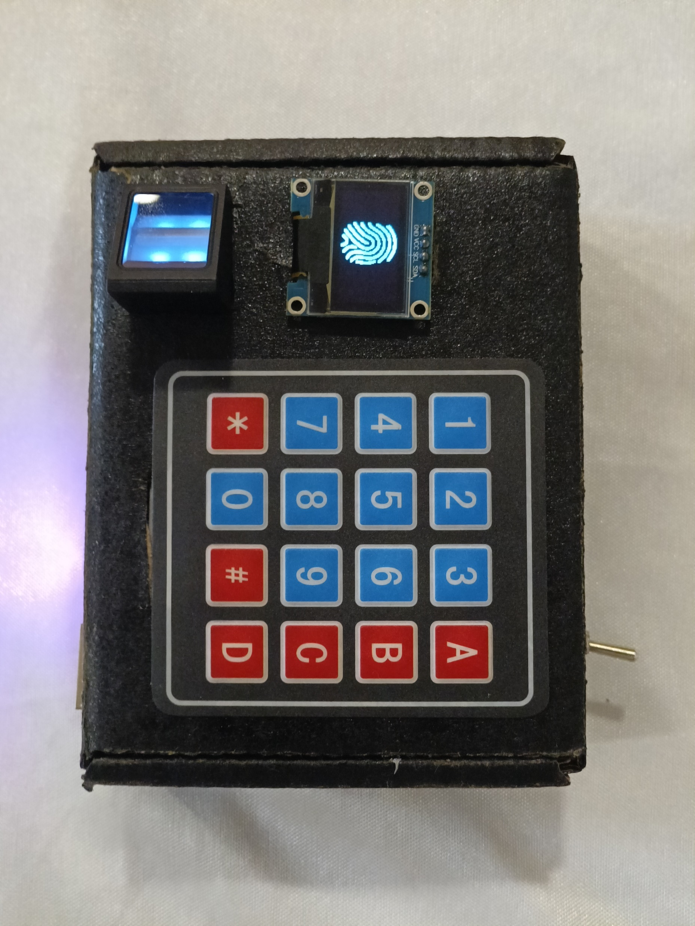
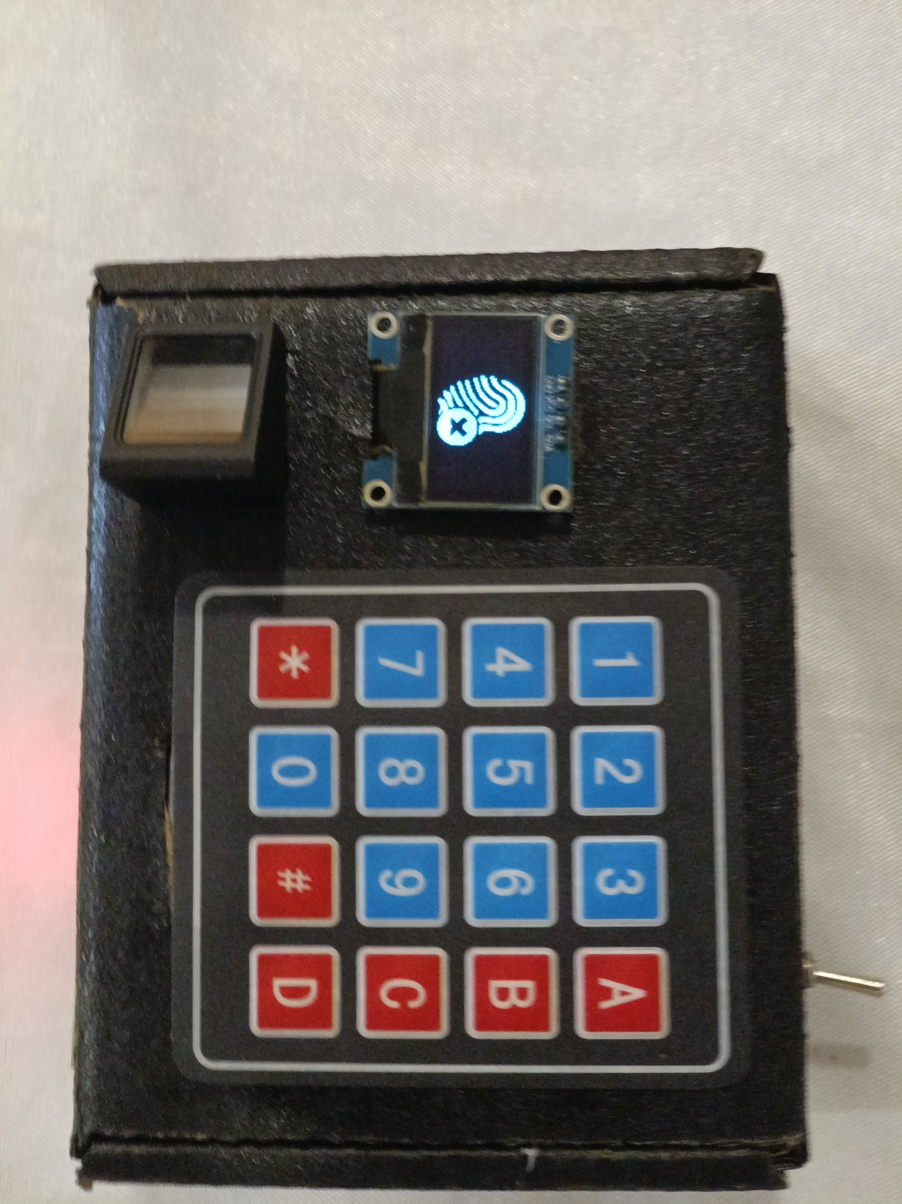
Result:
Fig.14 : Ready to accept fingerprint
Fig.15 :Fingerprint is invalid

Slide 30
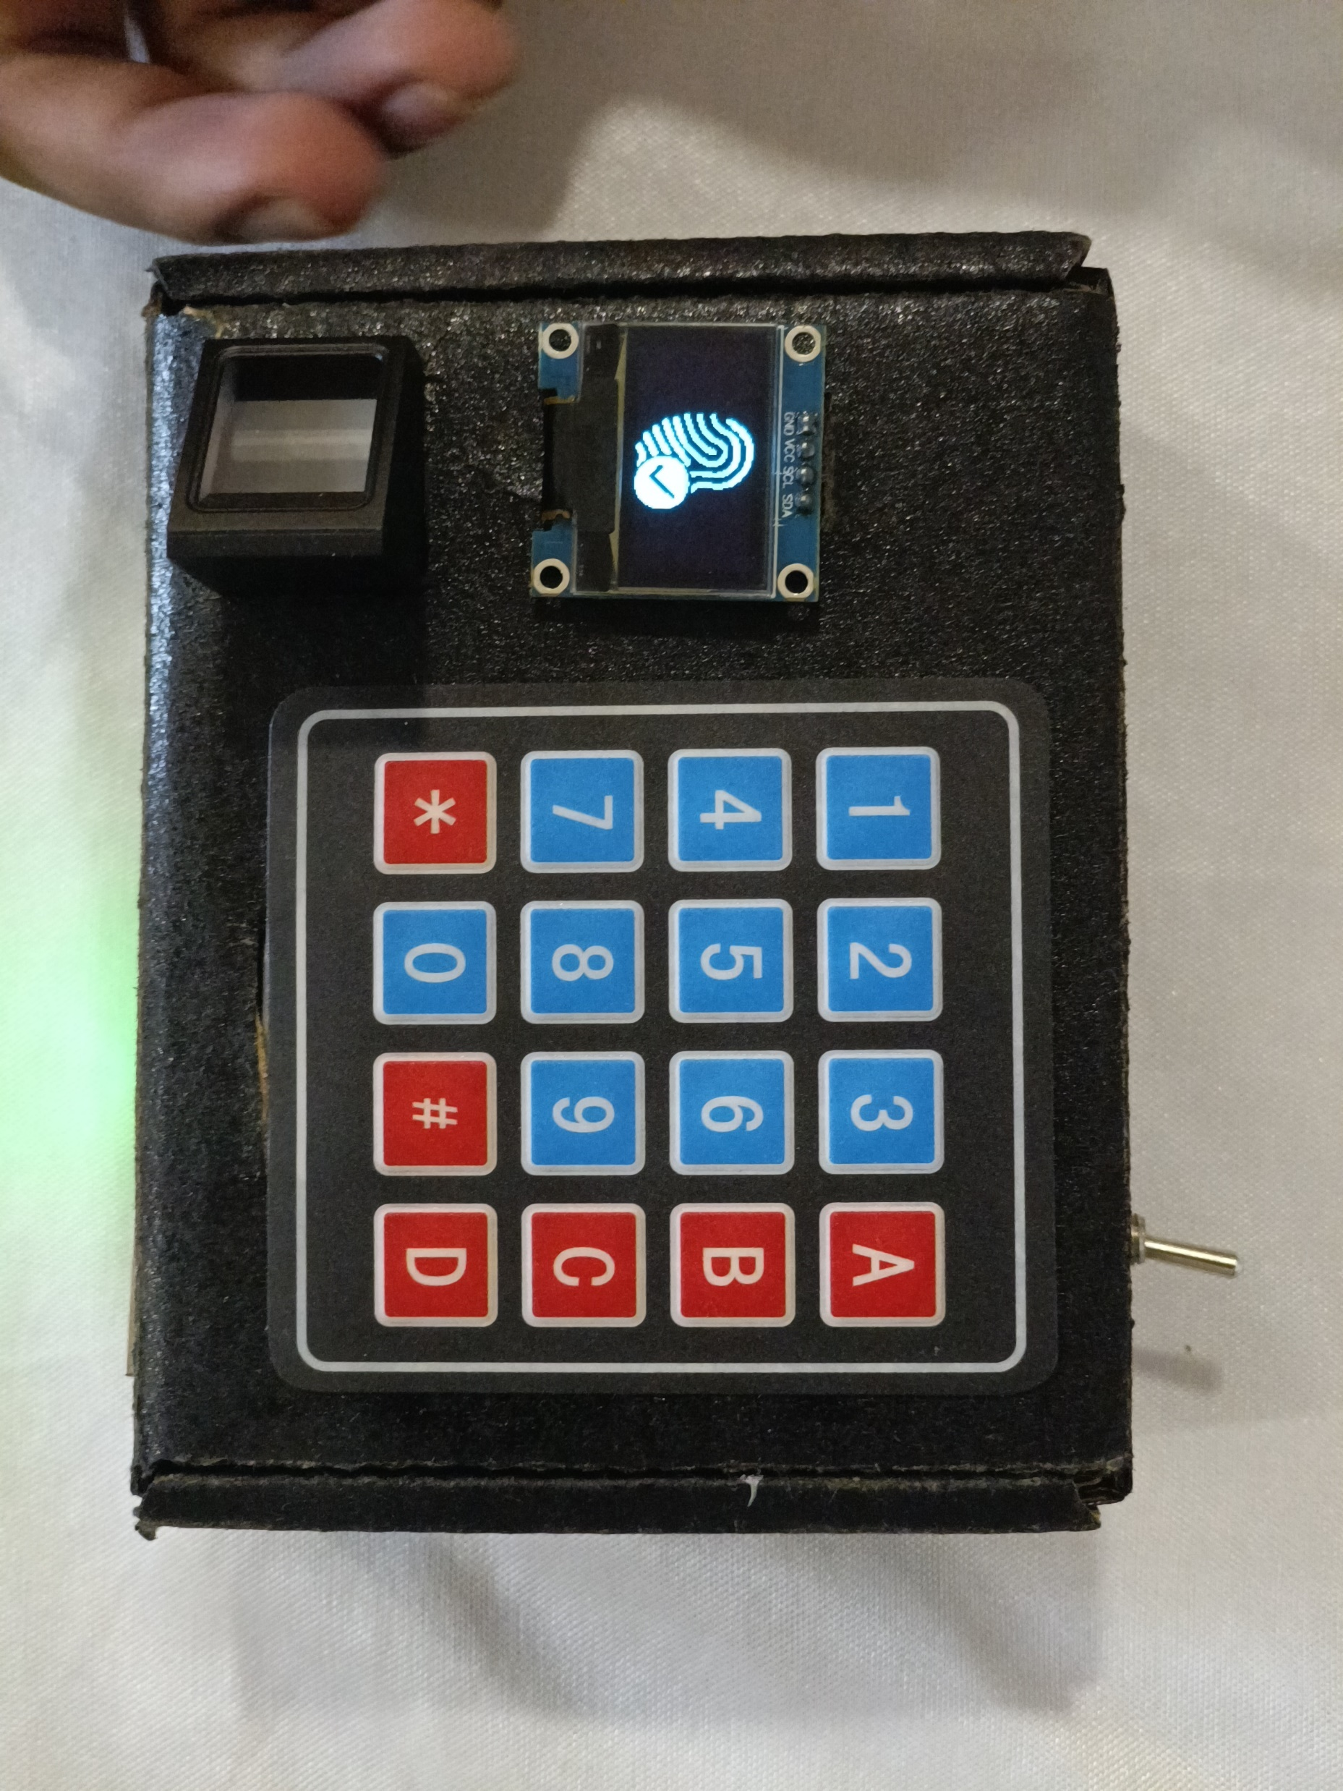
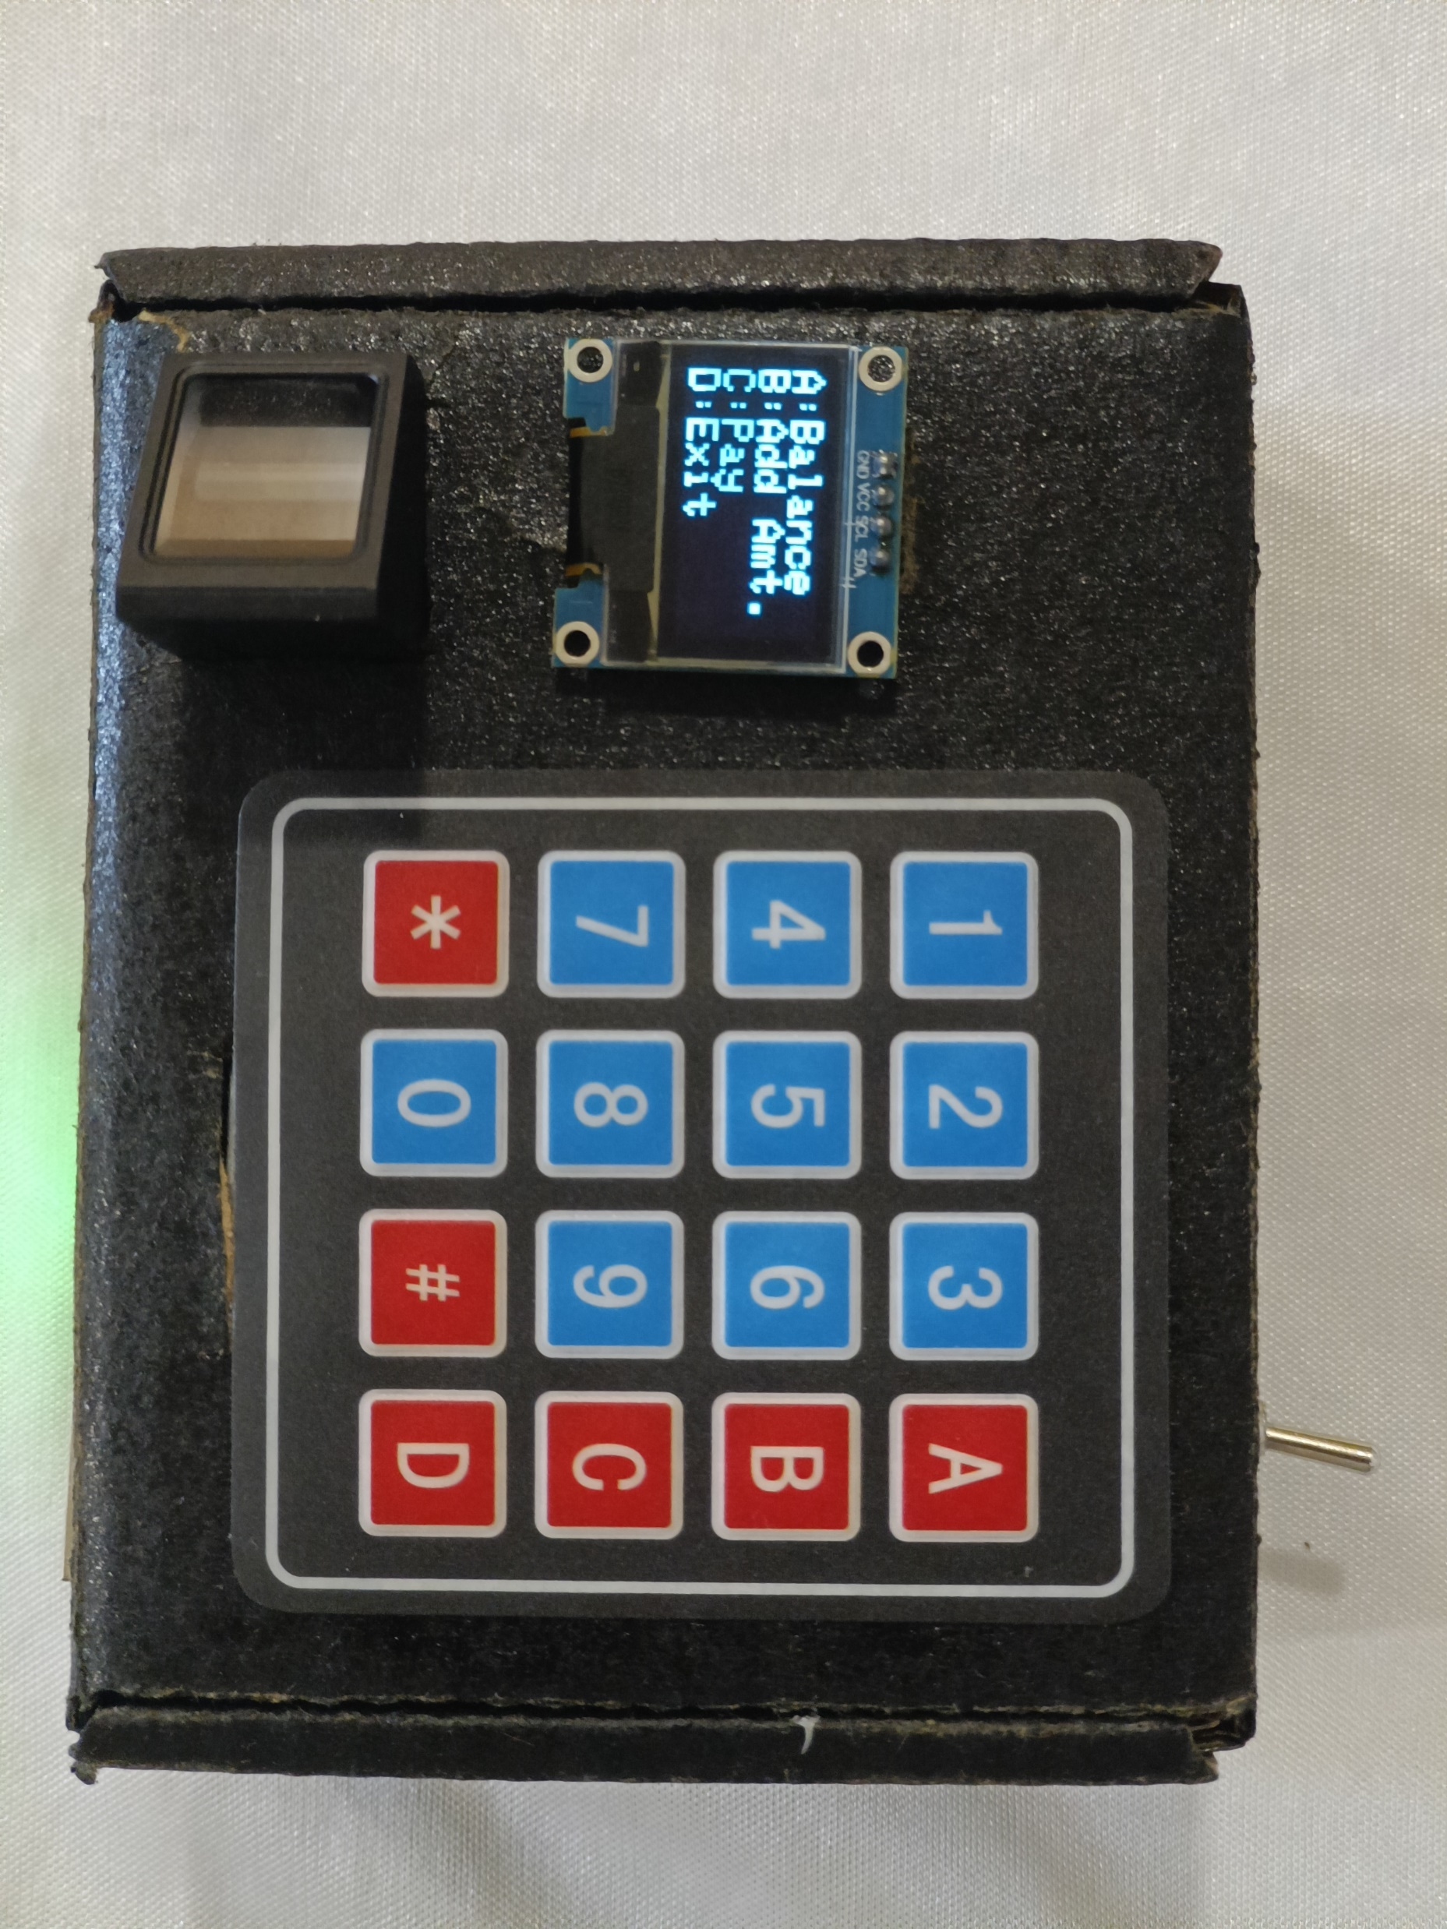
Fig.16 : Fingerprint Verified
Fig.17 : Options Window

Slide 31
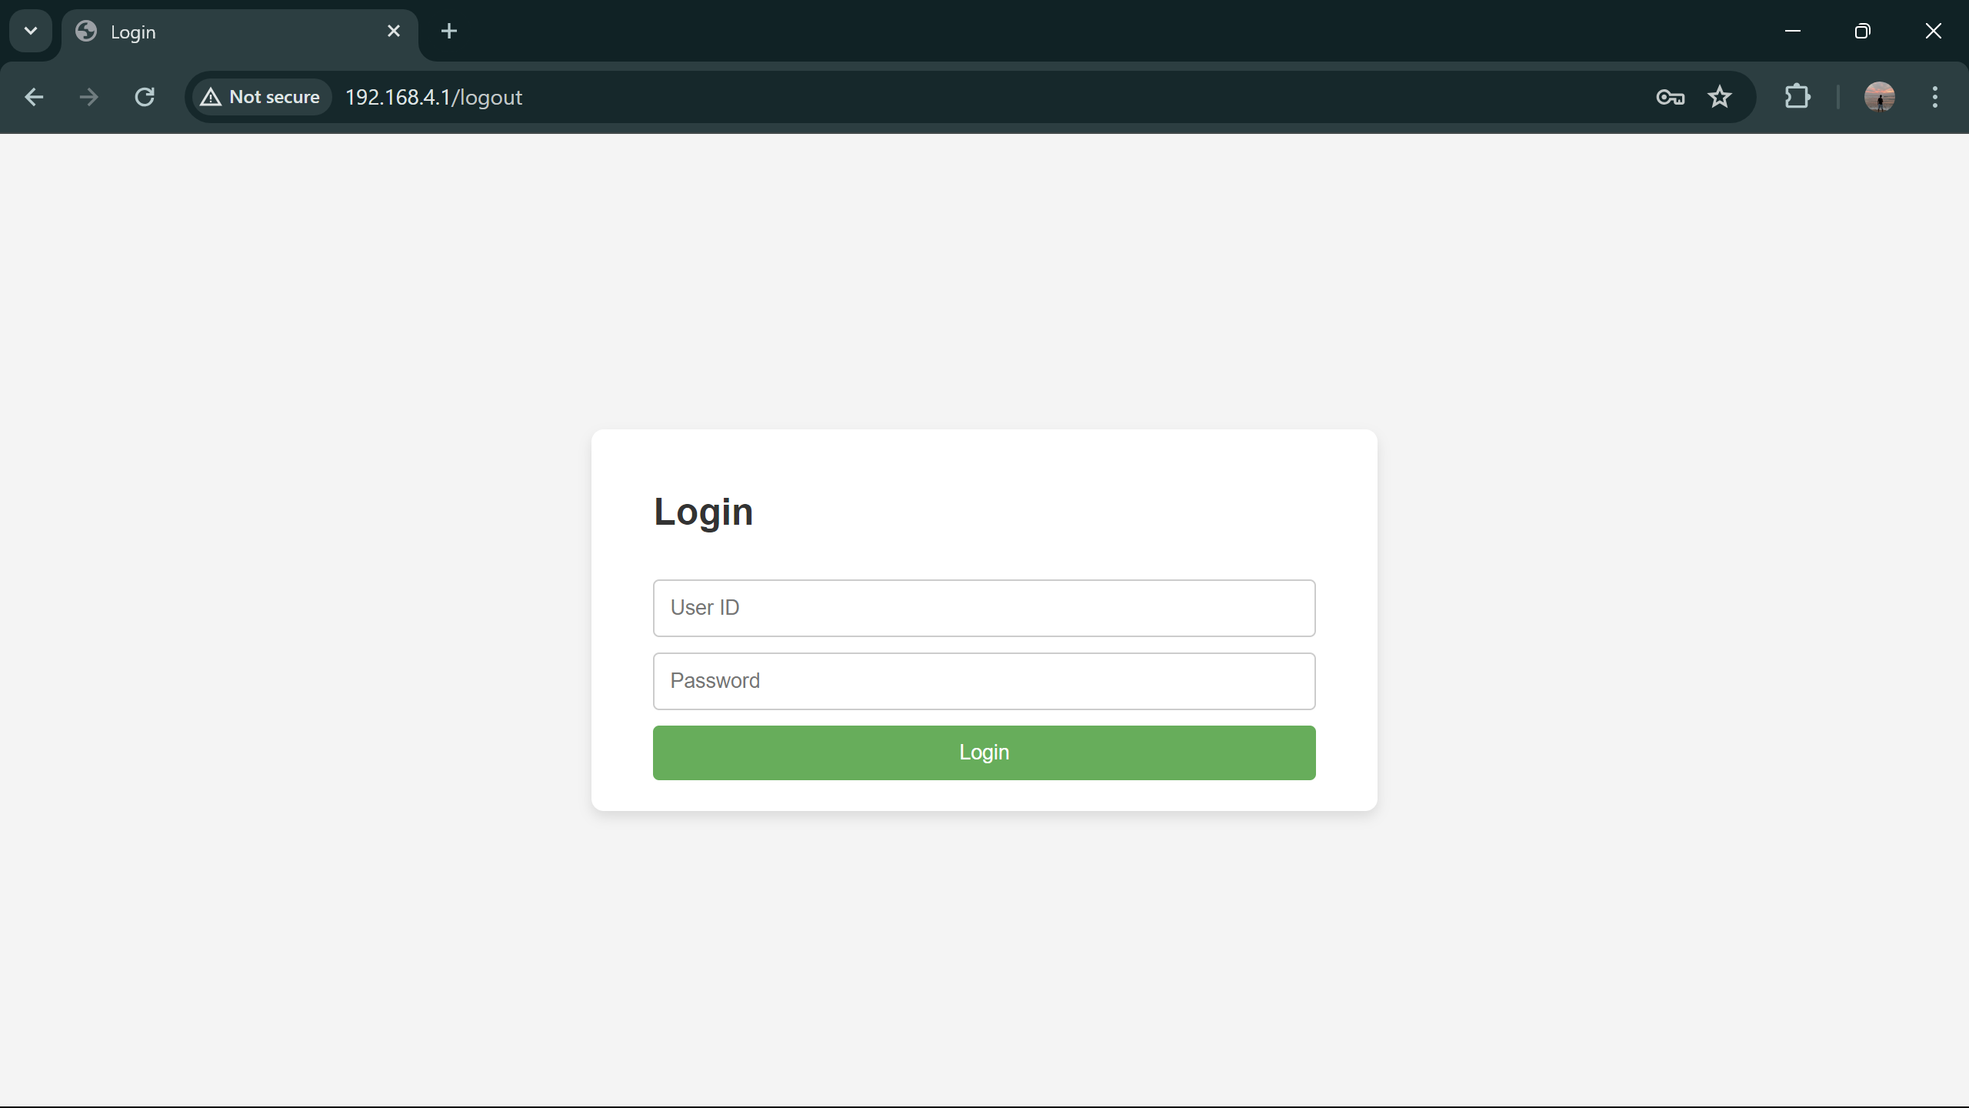
Fig.18 : Login Page

Slide 32
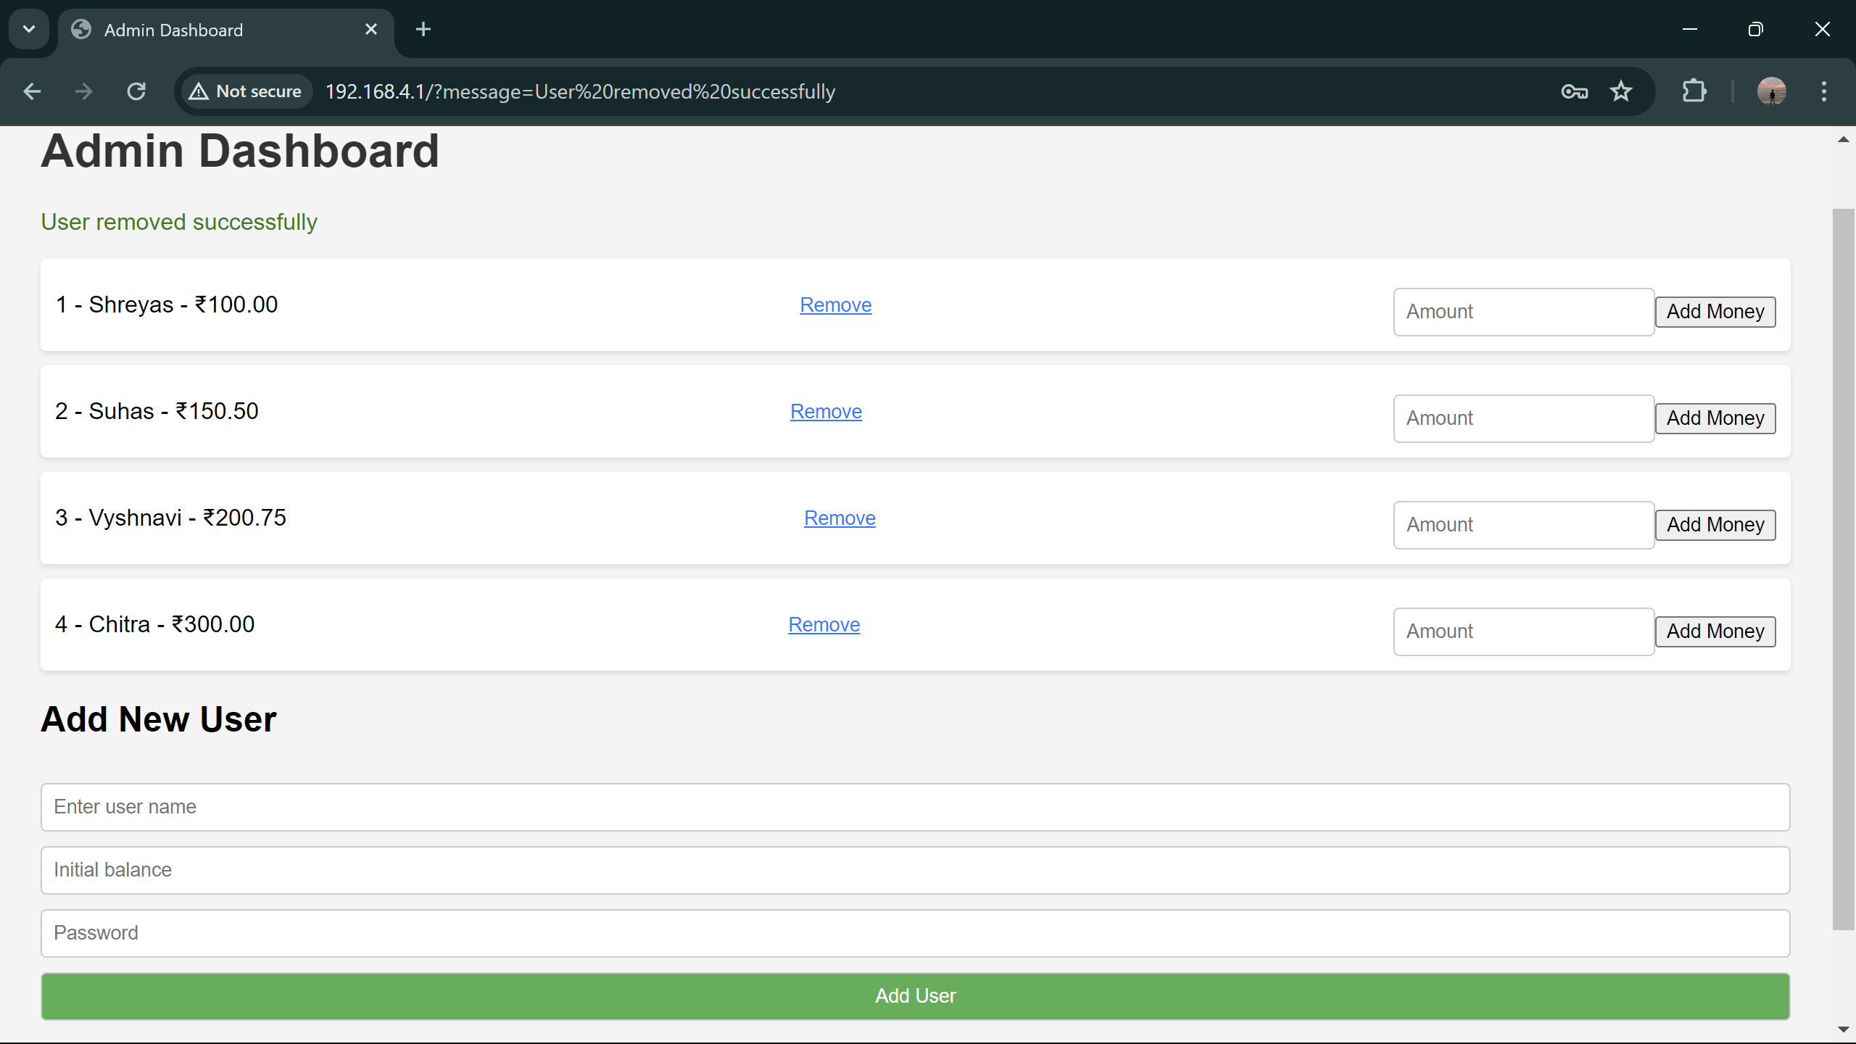
Fig.19 : Admin Dashboard

Slide 33
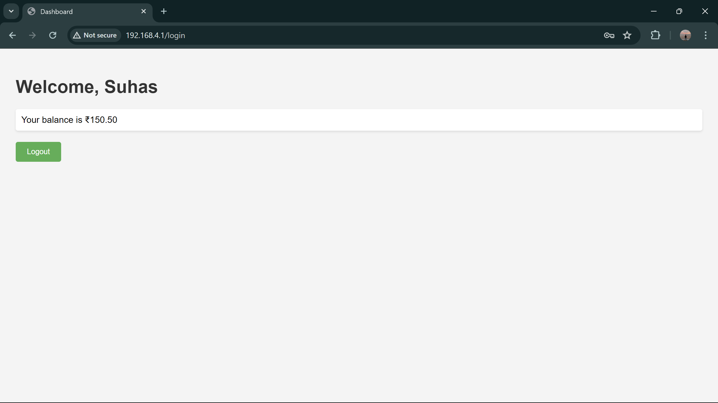
Fig.20 : User page

Slide 34
Technology Comparision:
Technology | A Biometric based Payment System by using Payee and Payer Module[3] | Biometric Based Payment System
Main control unit used | CORTEX M3 | ESP32
Operation | Two devices, one for payee and other of payer | Only one device with web application.
Display used | IPS display with VGA connector. | OLED display with I2C connection.
Input device | Keyboard, with USB (Universal Serial Bus) connector | 4X4 Matrix keypad, connected to GPIO pins of ESP32.
Communication | GSM | Wifi (for data connection)
On device encryption | NO | Hash encryption
Transmission protocol | NO | HTTP

Slide 35
Applications:
Financial Services
Cafeteria
Retail shops
Public transportation
Healthcare
Mobile Devices
Law Enforcement and Security
Travel and Immigration

Slide 36
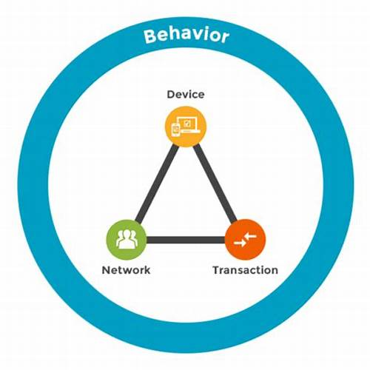
Advantages:
Enhanced security comes from unique biometric identifiers that are nearly impossible to forge.
Increased convenience is achieved by eliminating the need to carry cards, cash, or remember pins.
Faster transactions result from swift biometric scans that streamline the checkout process.
Reduced chance of fraud is due to the inherent security of biometric data, making it more difficult for criminals to steal.
Improved accessibility benefits people who struggle to remember pins.

Slide 37
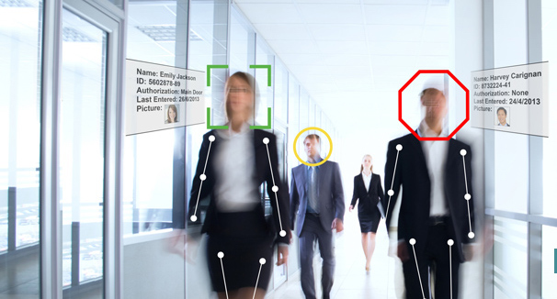
Limitations:
Privacy concerns exist because biometric data is highly sensitive and could be misused if security breaches occur.
Potential for false rejections due to cuts, bruises, illness, or changes to a person's biometric identifiers over time.
High implementation costs associated with specialized hardware and software required to implement biometric systems effectively.
Limitations for certain users as individuals with certain physical disabilities may find it difficult to use these systems.
Vulnerability to sophisticated spoofing where advanced techniques can be used to create fake biometric data.

Slide 38
Conclusion:
The system leverages fingerprint authentication, a well-established and reliable biometric modality for robust user verification.
A user-friendly interface, featuring a keypad and an OLED display, ensures intuitive interaction during the enrolment and payment processes.
To safeguard sensitive user information, the system employs encryption throughout. This encryption protects fingerprint templates in storage and ensures data integrity during transmission to a centralized MySQL database.
The system communicates efficiently with the central server using the HTTP protocol, enabling features like transaction history management through a web interface.
Finally, the implementation prioritizes affordability by carefully selecting readily available components such as the ESP32 microcontroller and the R307 fingerprint sensor, making this solution accessible for wider adoption.

Slide 39
Future scope:
Enhanced Security
Integration of additional biometric modalities (e.g., iris scan, facial recognition) can create a multi-factor authentication system, potentially offering even stronger security safeguards.
Improved Offline Functionality
Expanding offline capabilities would broaden the system's applicability to scenarios with intermittent network connectivity. This could involve secure local storage of encrypted transaction data and robust synchronization mechanisms.
Decentralized Security with Blockchain
Utilizing blockchain technology could introduce a decentralized approach to user identity and transaction management, potentially enhancing security and transparency.
Advanced User Convenience Features
The system's functionality could be extended to incorporate features such as balance top-up functionalities, loyalty program integration, or integration with existing mobile payment ecosystems.

Slide 40
REFERENCES
[1] Bin RONG and Chang-hua LIU “A Fingerprint Payment System Based on FPGA”, 2022 International Conference on Information System and Artificial Intelligence.
[2] Dileep Kumar and Yeonseung Ryu “A Brief Introduction of Biometrics and Fingerprint Payment Technology”, 2020 Second International Conference on Future Generation Communication and Networking Symposia.
[3] Dr.Chitra, Kiran.N , Suchira Suresh , AkarshS.M , BhuvanTeja , BhuvanTeja and Jerrin Y omas “A Biometric based Payment System by using Payee and Payer Module”, 2019 2nd IEEE International Conference On Recent Trends in Electronics Information & Communication Technology (RTEICT).
[4] R.Logeshwari, M.Saikotesw Ara, M.V.Sudeerkumar and J.S.R.K Suryateja “FINGERPRINT BASED ONLINE PAYMENT SYSTEM”, International Research Journal of Engineering and Technology (IRJET) ., Oct 2019.
[5] Yan Sui, Xukai Zou and Yinozi Du “Biometrics-Based Authentication: A New Approach”, 20th International Conference on Computer Communications and Networks (ICCCN)., 2018.

Slide 41
COURSE OUTCOMES
On completion of this course, we are able to
Get exposed to literature available for research challenges in interdisciplinary fields.
Get an insight of real world problems, challenges and related engineering issues to broader societal context.
Implement their idea using modern tools & new technologies
Demonstrate professionalism with ethics, individual & team management and effective communication skills to comprehend & to write reports.

Slide 42
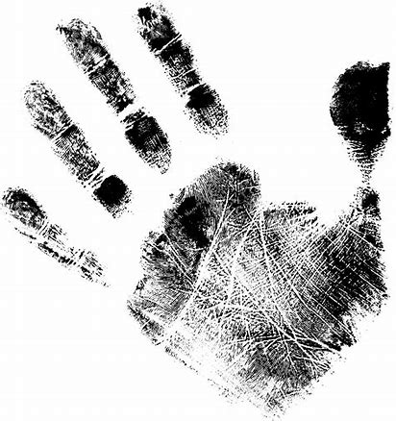

THANK YOU

